Slide 1

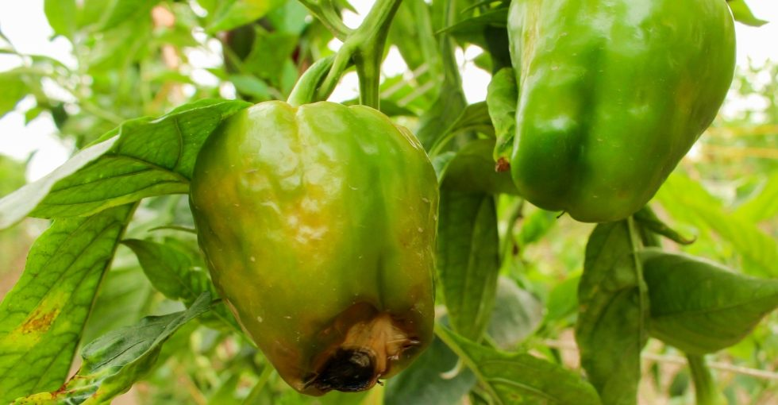
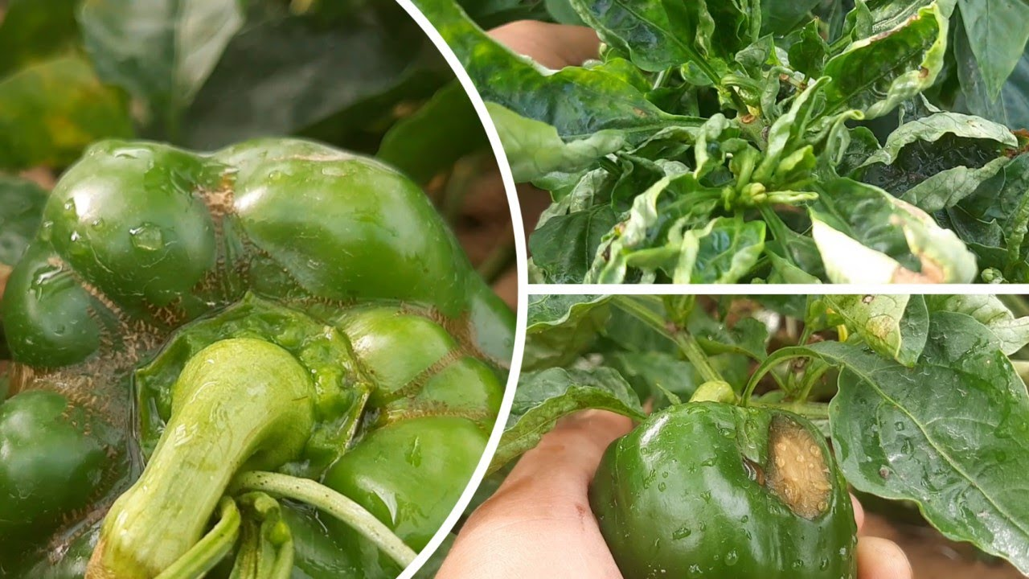
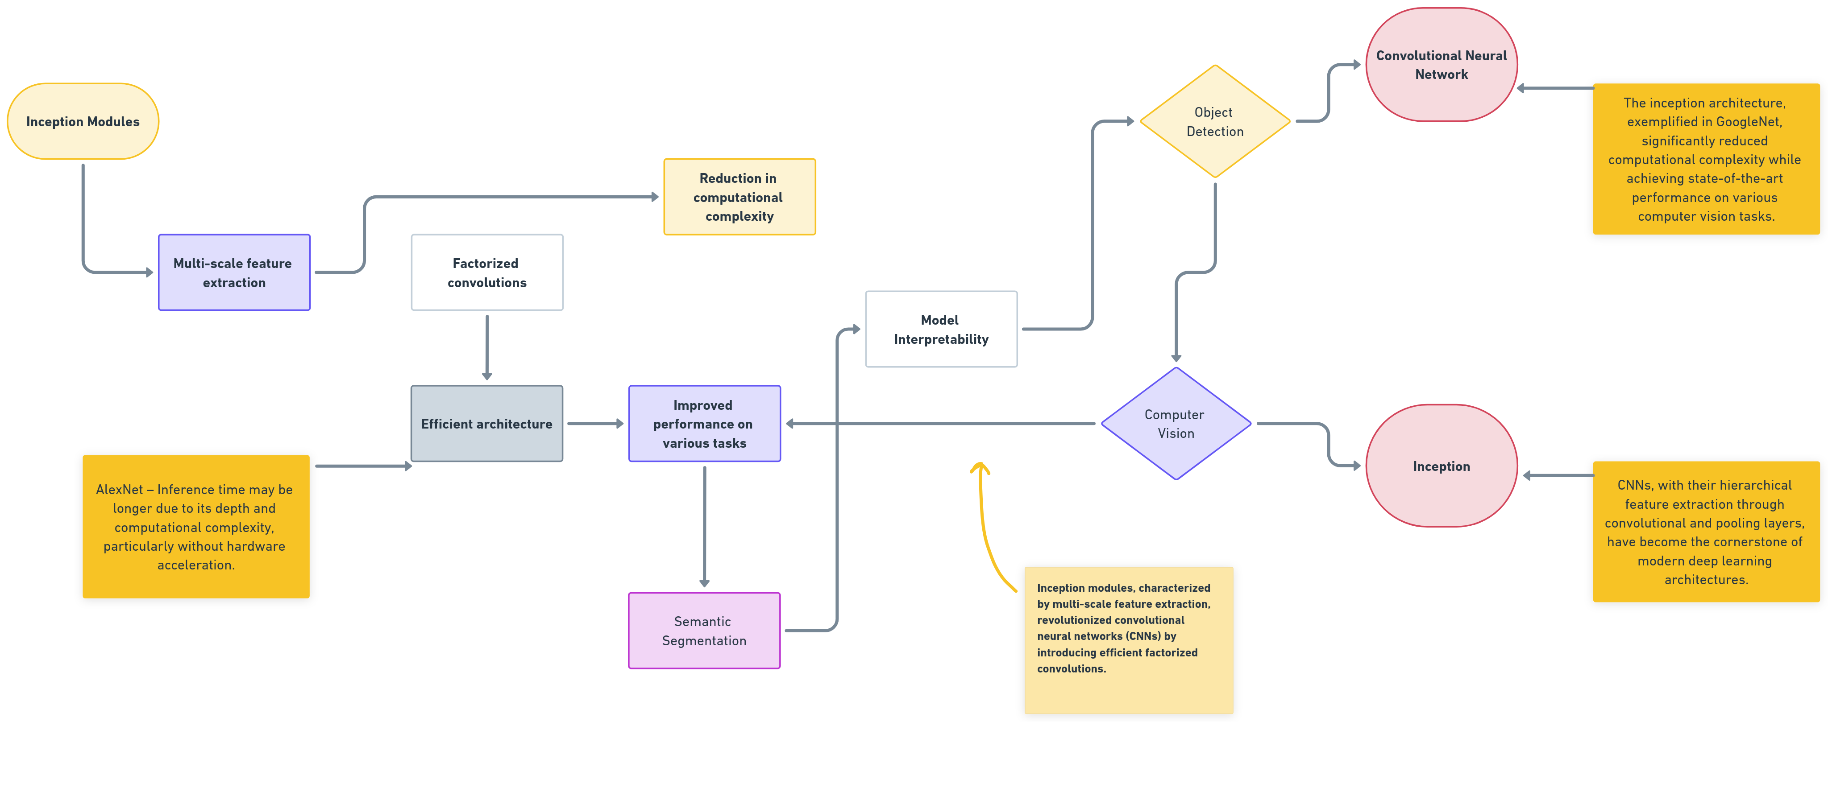
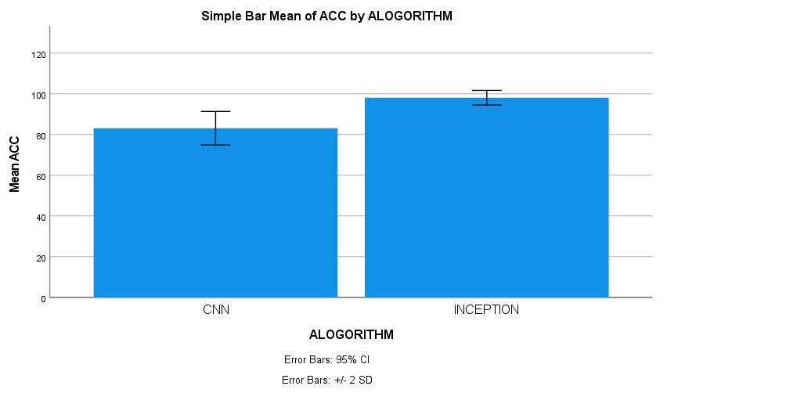
Name : Mr. Vigneshwaran P Register Number : 192124181
Guided by : Dr. C. Chandravathi
Ms. Poorani.S
Guided by Dr. Mary Valantina. G
Peppercheck: Deep Learning-based Bell Pepper Detection Disease using a various Convolutional Neural Network and Inception creating and training a deep learning model to recognize Bell Peppers Formation.
INTRODUCTION
Bell peppers (Capsicum annuum) are valued globally for their culinary diversity and nutritional richness. However, they face significant threats from various diseases and pests, jeopardizing crop yield and quality. To address these challenges, cutting-edge technologies like computer vision and deep learning are increasingly employed in agriculture.
This study investigates the efficacy of Convolutional Neural Networks (CNN) and InceptionV3 architectures for detecting bell pepper diseases through image analysis. CNNs, renowned for their hierarchical feature extraction, have been pivotal in image recognition tasks, including plant disease detection.
Conversely, inception modules offer a deeper and more intricate architecture, enhancing feature extraction from bell pepper images. By comparing these models, we aim to ascertain their accuracy in identifying prevalent bell pepper diseases, thus advancing precision agriculture solutions.
Such research promises to revolutionize disease management practices, bolster crop resilience, and ensure sustainable bell pepper production ensure food security in bell pepper production systems.
MATERIALS AND METHODS
Bell Pepper Detection Disease
RESULTS
The comparison between Convolutional Neural Networks (CNN) and traditional architectures for bell pepper disease detection yielded significant insights. CNN, renowned for its hierarchical feature extraction, demonstrated remarkable accuracy in detecting various bell pepper diseases.
Its ability to learn discriminative features from images enabled precise disease classification. Additionally, CNN's adaptability and scalability make it a versatile choice for agricultural applications. While traditional architectures lack the depth and complexity of CNNs, they still exhibit competence in disease detection tasks
Overall, CNN emerges as a robust solution for bell pepper disease detection, offering a balance between accuracy and computational efficiency. These findings underscore the potential of deep learning techniques in revolutionizing precision agriculture and improving crop management practices.
CNN and INCEPTION
Detecting bell peppers in images using Convolutional Neural Networks (CNN) and Inception Algorithm involves training these models on a dataset monitoring performance on the validation set to prevent overfitting. Use evaluation metrics such as accuracy and precision disease management is crucial for sustaining bell pepper production and ensuring food security
DISCUSSION AND CONCLUSION
Based on T-test Statistical analysis, the significance value of p=0.001 (independent sample T - test p<0.05) is obtained and shows that there is a statistical significant difference between the Group 1 and Group 2.
Overall , the accuracy of the Convolutional Neural Networks (CNN) is 98.12% and it is better than the Inception. Models undergo training on the training set, with adjustments made based on validation performance.
Convolutional Neural Networks (CNN) - 98.12 %
Inception Algorithm - 83.13 %
From the work, it is concluded that Convolutional Neural Networks (CNN) consistently demonstrate superior accuracy compared to Inception in the detection of bell pepper, highlighting the robustness and effectiveness of CNN architectures for image recognition tasks in agricultural contexts. A decision is then made between CNN and Inception architectures based on computational resources and performance requirements. The dataset is divided into training and validation sets, with potential augmentation techniques applied to increase variability.
BIBLIOGRAPHY
Simonyan, K., & Zisserman, A. (2015). "Very Deep Convolutional Networks for Large-Scale Image Recognition." ICLR. Proposes VGG architecture for image recognition. Features deep convolutional layers with small filters. Achieves state-of-the-art performance on various datasets. Emphasizes simplicity and interpretability. Influential work inspiring subsequent CNN architectures. Presented at the International Conference on Learning Representations.
He, K., Zhang, X., Ren, S., & Sun, J. (2016). "Identity Mappings in Deep Residual Networks." ECCV, 630-645. Introduces ResNet with identity mappings. Addresses vanishing gradient problem in deep networks. Enables training of very deep neural networks. Achieves state-of-the-art results in image recognition. Residual connections facilitate gradient flow. Presented at the European Conference on Computer Vision.
Szegedy, C., Vanhoucke, V., Ioffe, S., Shlens, J., & Wojna, Z. (2016). "Rethinking the Inception Architecture for Computer Vision." CVPR, 2818-2826. Proposes revisions to Inception architecture. Introduces Inception v4 and Inception-ResNet modules. Achieves state-of-the-art results in computer vision tasks.
Howard, A. G., et al. (2017). "MobileNets: Efficient Convolutional Neural Networks for Mobile Vision Applications." arXiv:1704.04861. Introduces MobileNets for mobile vision applications. Focuses on efficiency and lightweight architecture. Suitable for resource-constrained environments. Achieves competitive performance with reduced computational cost. Addresses the need for efficient deep learning models. Presented as an arXiv preprint.

